Slide 1
HR ANALYTICS DASHBOARD
SQL + Power BI PROJECT

Slide 2
PROBLEM STATEMENT SUMMARY
Organizations are struggling to get a handle on why employees leave how workers are spread out across the company and what makes employees happy on the job. This lack of understanding leads to strategies for keeping employees and bad decisions from HR.
The HR data that is available has a lot of information on employees like where they come from what department they work in what they studied, what their job is and how satisfied they are with their work.. All this data is not being used to get useful insights that can help.
The main issue here is employee attrition. Organizations are struggling with employee attrition. They are also struggling to understand workforce distribution.
They are struggling to understand job satisfaction patterns. All these struggles lead to retention strategies. They also lead to HR decision-making.
The available HR data contains information on employee demographics. It also contains information on departments.
There is information on education. There is information on job roles. There is information, on satisfaction levels.
It is not being effectively analyzed. It is not being used to generate insights.

Slide 3
DELIVERABLES
1. Data Preparation & Modelling (MS-Excel): Clean and transform the raw dataset for analysis.
2. Data Analysis (SQL): Organize the data into a structured format, simulate business transactions,
and run queries to extract insights on customer segments, loyalty, and purchase drivers.
3. Visualization & Insights (Power BI): Build an interactive dashboard that highlights key patterns and trends,
enabling stakeholders to make data-driven decisions.
4. Report and Presentation: Write a clear project report summarizing your key findings and business
recommendations. Prepare a presentation that visually communicates insights and actionable recommendations to stakeholders.
5. GitHub Repository: Include all Python scripts, SQL queries, and dashboard files in a well-structured repository.

Slide 4
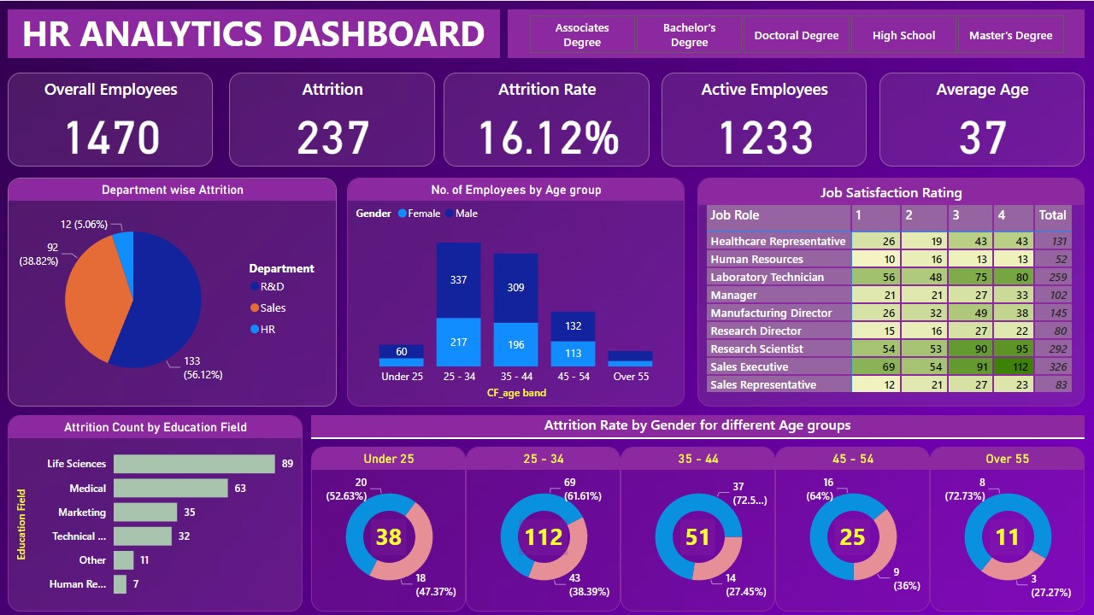

Slide 5
KEY BUSINESS INSIGHTS
Attrition Rate is 16.12% (237 employees) → This is not low, it’s a retention problem.
Sales (38.82%) and R&D (56.12%) dominate attrition → Core business functions are bleeding talent.
Age group 25–34 has the highest employee count AND highest attrition (112) → Mid-career instability.
Life Sciences (89) and Medical (63) show highest attrition by education → Specialized talent loss.
Sales Executive (326 total) has high dissatisfaction and attrition exposure → High-risk role.
Job satisfaction varies heavily across roles → Not a company-wide issue, it’s role-specific.
Male employees show slightly higher attrition in most age groups → Possible workload or role imbalance.

Slide 6
ROOT CAUSE ANALYSIS
High Role Pressure in Key Departments
Attrition is heavily concentrated in Sales and R&D, which are critical revenue and innovation functions.
This indicates high performance pressure, tight deadlines, and workload stress contributing to employee exits.
Lack of Career Growth for Mid-Level Employees
Employees in the 25–34 age group show the highest attrition.
This suggests limited career progression opportunities, slow promotions, or lack of skill development, leading to frequent job switches.

Slide 7
ROOT CAUSE ANALYSIS
Uneven Job Satisfaction Across Roles
Job satisfaction levels vary significantly between roles.
Roles such as Sales Executive and HR show relatively lower satisfaction, indicating inconsistent management practices, incentives, or work conditions.
Loss of Specialized Talent
Higher attrition is observed among employees from Life Sciences and Medical backgrounds.
This points to high market demand and competitive offers, making it difficult to retain skilled professionals.

Slide 8
ROOT CAUSE ANALYSIS
Absence of Targeted Retention Strategies
Attrition is concentrated in specific departments, roles, and demographics rather than being evenly distributed.
This indicates the organization is relying on generic HR policies instead of data-driven, targeted retention strategies.

Slide 9
Conclusion
The company is facing significant attrition (16.12%), especially in Sales and R&D departments.
Mid-career employees (25–34) are the most affected group, indicating gaps in career growth and engagement.
Attrition is not random — it is driven by role pressure, job dissatisfaction, and lack of targeted HR strategies.
Immediate, data-driven interventions are required to reduce attrition and stabilize workforce performance.

